Slide 1
Guideline for Protection module: To know Access matrix you have to get an idea of principles of protection, domain of protection, access matrix with object and domains etc.
What are the strengths and weaknesses of implementing an access matrix using access lists that are associated with objects?
Ans: The strength of storing an access list with each object is the control that comes from storing the access privileges along with each object, thereby allowing the object to revoke or expand the access privileges in a localized manner. The weakness with associating access lists is the overhead of checking whether the requesting domain appears on the access list. This check would be expensive and needs to be performed every time the object is accessed.

Slide 2
Objectives
Discuss the goals and principles of protection in a modern computer system
Explain how protection domains combined with an access matrix are used to specify the resources a process may access
Examine capability-based protection systems

Slide 3
Goals of Protection
In one common protection model, a computer consists of a collection of objects, hardware or software
Each object has a unique name and can be accessed through a well-defined set of operations
Protection problem - ensure that each object is accessed correctly and only by those processes that are allowed to do so

Slide 4
Principles of Protection
Guiding principle – principle of least privilege
Static
Dynamic - domain switching, privilege escalation
“Need to know” a similar concept regarding access to data
“Containment of failure”
Must consider “grain” aspect
Rough-grained
Fine-grained
Domain can be user, process, procedure

Slide 5
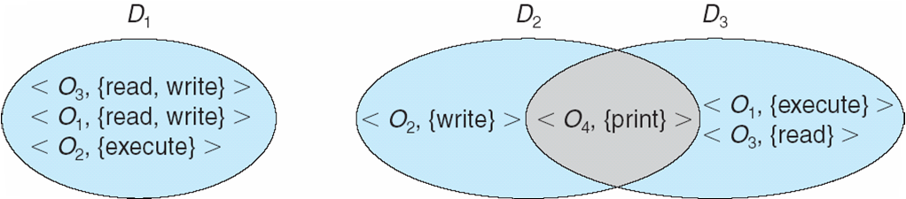
Domain Structure
Access-right = <object-name, rights-set> where rights-set is a subset of all valid operations that can be performed on the object
Domain = set of access-rights

Slide 6
Domain Implementation (UNIX)
Domain = user-id
Domain switch accomplished via file system
Each file has associated with it a domain bit (setuid bit)
When file is executed and setuid = on, then user-id is set to owner of the file being executed (similary “setgid”)
When execution completes user-id is reset
Domain switch accomplished via passwords
su command temporarily switches to another user’s domain when other domain’s password provided
Domain switching via commands
sudo command prefix executes specified command in another domain (if original domain has privilege or password given)

Slide 7
Access Matrix
View protection as a matrix (access matrix)
Rows represent domains
Columns represent objects
Access(i, j) is the set of operations that a process executing in Domain_{i} can invoke on Object_{j}

Slide 8
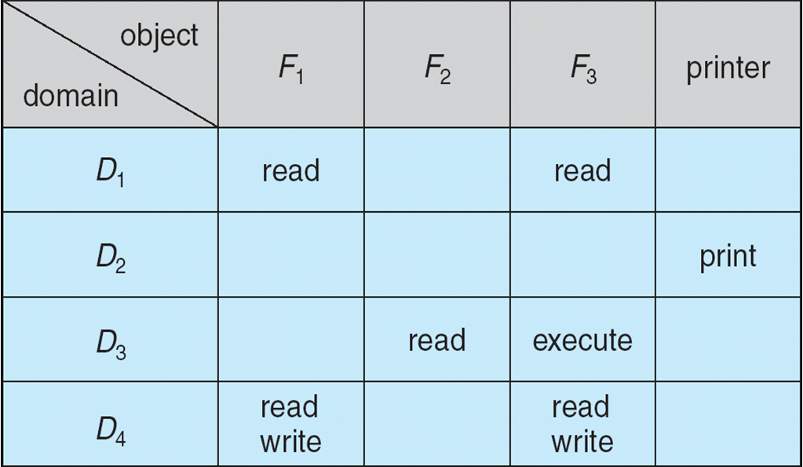
Access Matrix

Slide 9
Use of Access Matrix
If a process in Domain D_{i} tries to do “op” on object O_{j}, then “op” must be in the access matrix
User who creates object can define access column for that object
Can be expanded to dynamic protection
Operations to add, delete access rights
Special access rights:
owner of O_{i}
copy op from D_{i} to D_{j} (denoted by “*”)
control – D_{i} can modify D_{j} access rights
transfer (switch) – switch from domain D_{i} to D_{j}
Copy and Owner applicable to an object
Control applicable to domain

Slide 10
Use of Access Matrix (Cont.)
Access matrix design separates mechanism from policy
Mechanism
Operating system provides access-matrix + rules
It ensures that the matrix is only manipulated by authorized agents and that rules are strictly enforced
Policy
User dictates policy
Who can access what object and in what mode
Good policy supported by good default values

Slide 11
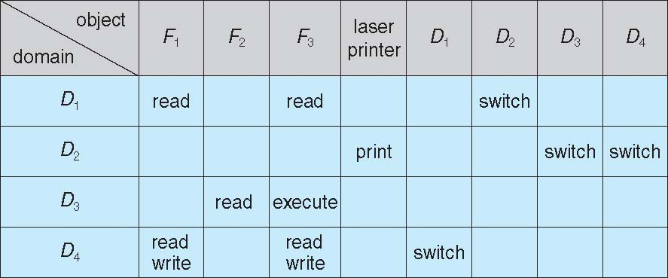
Access Matrix Example

Slide 12
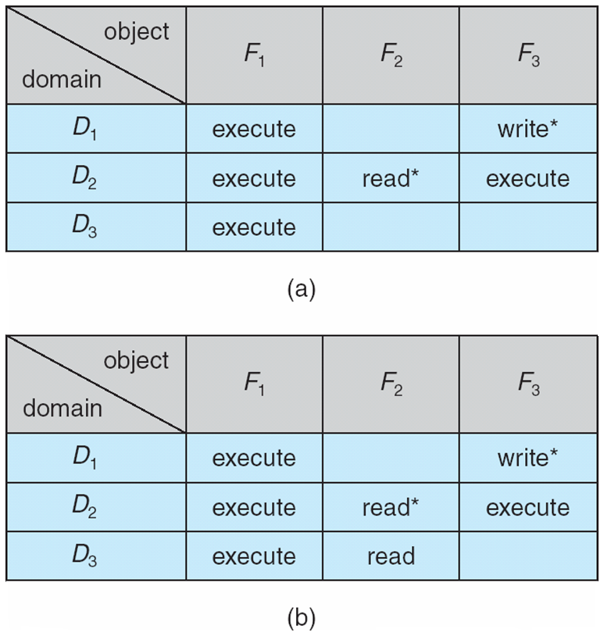
Access Matrix Example

Slide 13
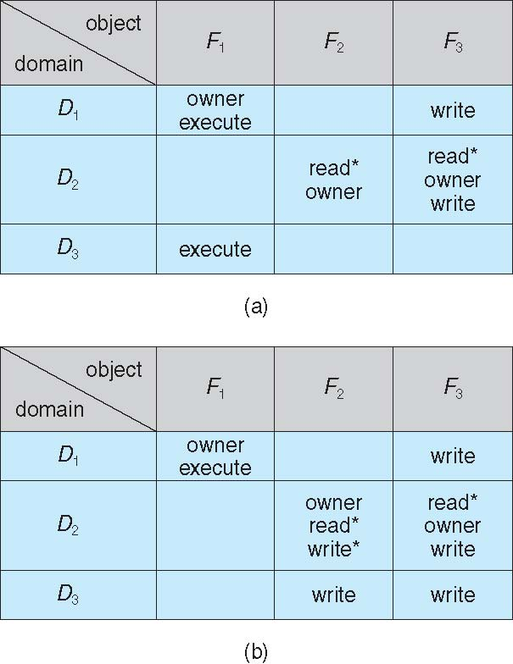
Access Matrix Example

Slide 14
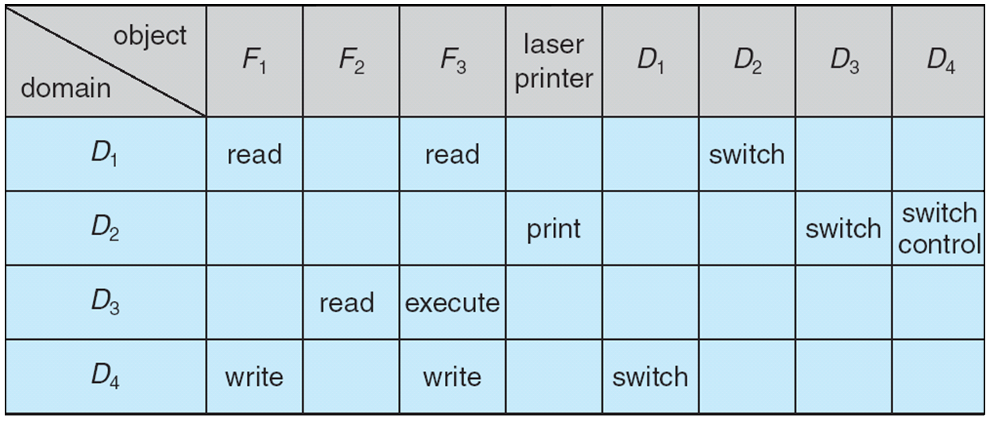
Access Matrix Example

